Slide 1
Linear Algebra and Matrices
Dr. Bhawana Rudra
NITK

Slide 2
Talk Outline
Scalars, vectors and matrices
Vector and matrix calculations
Identity, inverse matrices & determinants
Solving simultaneous equations
Relevance to SPM

Slide 3

Scalar
Variable described by a single number
e.g. Intensity of each voxel in an MRI scan

Slide 4
Vector
Not a physics vector (magnitude, direction)
Column of numbers e.g. intensity of same voxel at different time points

Slide 5
Matrices
Rectangular display of vectors in rows and columns
Can inform about the same vector intensity at different times or different voxels at the same time
Vector is just a n x 1 matrix
Square (3 x 3) Rectangular (3 x 2) d _{i j} : i^{th} row, j^{th} column
Defined as rows x columns (R x C)

Slide 6
Matrices in Matlab
X=matrix
;=end of a row
:=all row or column
Subscripting – each element of a matrix can be addressed with a pair of numbers; row first, column second (Roman Catholic)
e.g. X(2,3) = 6
X(3, :) =
X( [2 3], 2) =
“Special” matrix commands:
zeros(3,1) =
ones(2) =
magic(3) =

Slide 7

Design matrix
= the betas
(here : 1 to 9)
design
matrix
parameters
data
vector
error
vector
α
μ
β₃
β₄
β₅
β₆
β₇
β₈
β₉
=
+
Y
=
X
×
β
+
ε

Slide 8
Transposition
column row row column

Slide 9
Matrix Calculations
Addition
Commutative: A+B=B+A
Associative: (A+B)+C=A+(B+C)
Subtraction
- By adding a negative matrix

Slide 10

Scalar multiplication
Scalar x matrix = scalar multiplication

Slide 11
Matrix Multiplication
“When A is a mxn matrix & B is a kxl matrix, AB is only possible if n=k. The result will be an mxl matrix”
n
l
A₁ A₂ A₃
A₄ A₅ A₆
A₇ A₈ A₉
A₁₀ A₁₁ A₁₂
B₁₃ B₁₄
B₁₅ B₁₆
B₁₇ B₁₈
m
x
k
= m x l matrix
Number of columns in A = Number of rows in B

Slide 12
Matrix multiplication
Multiplication method:
Sum over product of respective rows and columns
X
=
Define output matrix
A
B
=
Matlab does all this for you!
Simply type: C = A * B
=

Slide 13
Matrix multiplication
Matrix multiplication is NOT commutative
AB≠BA
Matrix multiplication IS associative
A(BC)=(AB)C
Matrix multiplication IS distributive
A(B+C)=AB+AC
(A+B)C=AC+BC

Slide 14
Vector Products
Two vectors:
Inner product X^{T}Y is a scalar
(1xn) (nx1)
Inner product = scalar
Outer product = matrix
Outer product XY^{T} is a matrix
(nx1) (1xn)

Slide 15
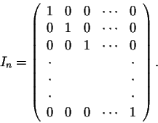
Identity matrix
Is there a matrix which plays a similar role as the number 1 in number multiplication?
Consider the nxn matrix:
For any nxn matrix A, we have A I_{n} = I_{n} A = A
For any nxm matrix A, we have I_{n} A = A, and A I_{m} = A (so 2 possible matrices)

Slide 16
Identity matrix
Worked example
A I₃ = A
for a 3x3 matrix:
1 | 2 | 3 |  | 1 | 0 | 0 |  | 1+0+0 | 0+2+0 | 0+0+3
4 | 5 | 6 | X | 0 | 1 | 0 | = | 4+0+0 | 0+5+0 | 0+0+6
7 | 8 | 9 |  | 0 | 0 | 1 |  | 7+0+0 | 0+8+0 | 0+0+9
In Matlab: eye(r, c) produces an r x c identity matrix

Slide 17
Matrix inverse
Definition. A matrix A is called nonsingular or invertible if there exists a matrix B such that:
1 | 1 | X | 2 3 | -1 3 | = | 2 + 1 3 3 | -1 + 1 3 3 | = | 1 | 0
-1 | 2 |  | 1 3 | 1 3 |  | -2+ 2 3 3 | 1 + 2 3 3 |  | 0 | 1
Notation. A common notation for the inverse of a matrix A is A⁻¹. So:
The inverse matrix is unique when it exists. So if A is invertible, then A⁻¹ is also invertible and then (A^{T})⁻¹ = (A⁻¹)^{T}
In Matlab: A⁻¹ = inv(A)
Matrix division: A/B= A*B⁻¹

Slide 18



Matrix inverse
For a XxX square matrix:
The inverse matrix is:
E.g.: 2x2 matrix

Slide 19
Determinants
Determinants are mathematical objects that are very useful in the analysis and solution of systems of linear equations (i.e. GLMs).
The determinant is a function that associates a scalar det(A) to every square matrix A.
Input is nxn matrix
Output is a single number (real or complex) called the determinant
Linear Algebra & Matrices, MfD 2009

Slide 20
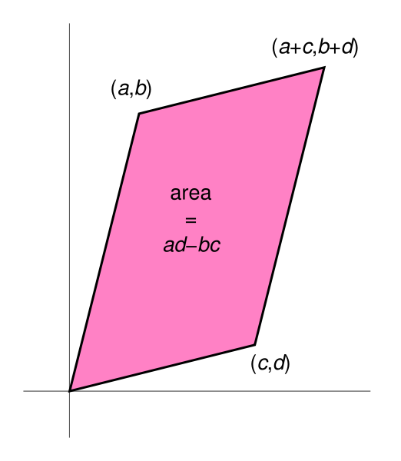
Determinants
Determinants can only be found for square matrices.
For a 2x2 matrix A, det(A) = ad-bc. Lets have at closer look at that:
[ ]
det(A) =
a b
c d
= ad - bc
In Matlab: det(A) = det(A)
A matrix A has an inverse matrix A⁻¹ if and only if det(A)≠0.

Slide 21
Solving simultaneous equations
For one linear equation ax=b where the unknown is x and a and b are constants,
3 possibilities:

Slide 22
With >1 equation and >1 unknown
Can use solution from the single equation to solve
For example
In matrix form
A X = B
X =A⁻¹B

Slide 23
X =A⁻¹B
To find A⁻¹
Need to find determinant of matrix A
From earlier
(2 -2) – (3 1) = -4 – 3 = -7
So determinant is -7

Slide 24
if B is
So

Slide 25
How are matrices relevant to fMRI data?

Slide 26
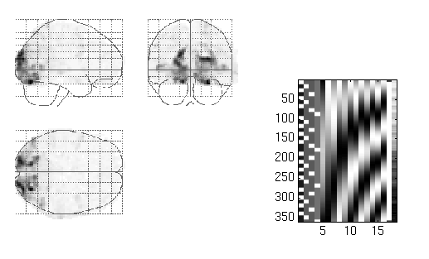
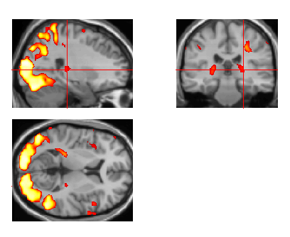
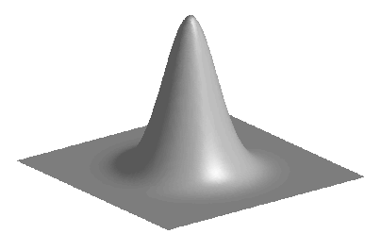
Image time-series
Spatial filter
Design matrix
Statistical Parametric Map
Realignment
Smoothing
General Linear Model
Statistical Inference
RFT
Normalisation
Anatomical reference
p <0.05
Parameter estimates

Slide 27
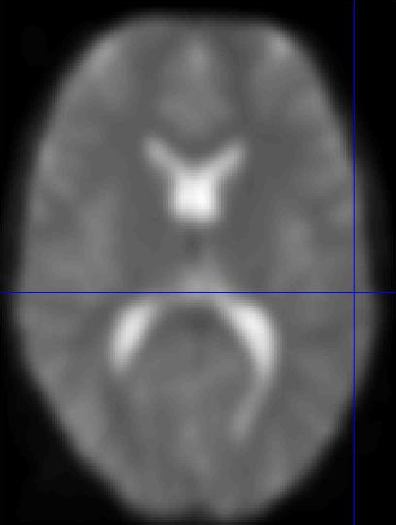
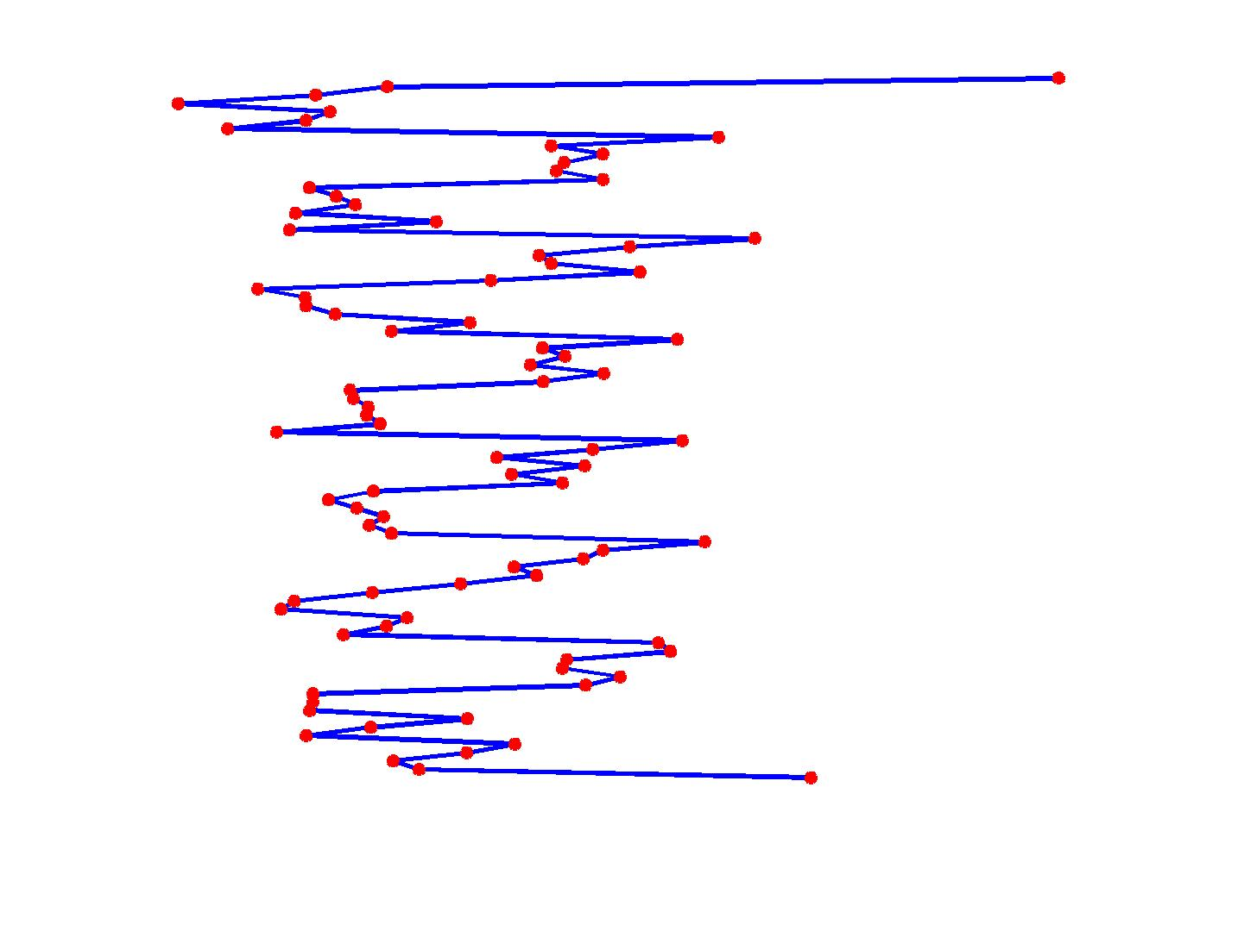
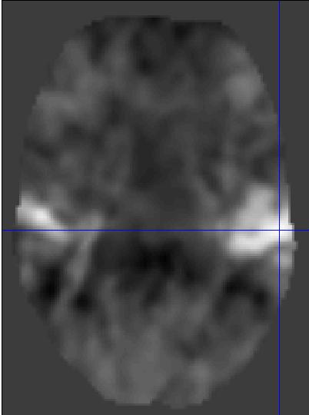
Voxel-wise time series analysis
Model
specification
Parameter
estimation
Time
Hypothesis
Statistic
Time
BOLD signal
single voxel
time series
SPM

Slide 28
How are matrices relevant to fMRI data?
design
matrix
parameters
GLM equation
data
vector
error
vector
α
μ
β₃
β₄
β₅
β₆
β₇
β₈
β₉
N of scans
=
+
Y
=
X
×
β
+
ε
Notes:
The General Linear Model is an equation that expresses the observed response variable in terms of a linear combination of explanatory variables X plus a well behaved error term. Each column of the design matrix corresponds to an effect one has built into the experiment or that may confound the results.

Slide 29



How are matrices relevant to fMRI data?
data
vector
Preprocessing ...
Response variable
e.g BOLD signal at a particular voxel
A single voxel sampled at successive time points.
Each voxel is considered as independent observation.
Y
Time
Time
Intensity
Y
Y = X . β + ε
Notes:
Consider that data measured includes
Response variable
e.g BOLD signal at a particular voxel
Many scalars for this one voxel
Explanatory variables
These are assumed to be measured without error
May be continuous; May be dummy indicating levels of an experimental factor

Slide 30
How are matrices relevant to fMRI data?
design
matrix
parameters
Explanatory variables
These are assumed to be measured without error.
May be continuous;
May be dummy, indicating levels of an experimental factor.
α
μ
β₃
β₄
β₅
β₆
β₇
β₈
β₉
Solve equation for β – tells us how much of the BOLD signal is explained by X
X
×
β
Y = X . β + ε
Notes:
Consider that data measured includes
Response variable
e.g BOLD signal at a particular voxel
Many scalars for this one voxel
Explanatory variables
These are assumed to be measured without error
May be continuous; May be dummy indicating levels of an experimental factor

Slide 31
In Practice
Estimate MAGNITUDE of signal changes
MR INTENSITY levels for each voxel at various time points
Relationship between experiment and voxel changes are established
Calculation and notation require linear algebra

Slide 32
Summary
SPM builds up data as a matrix.
Manipulation of matrices enables unknown values to be calculated.
Y = X . β + ε
Observed = Predictors * Parameters + Error
BOLD = Design Matrix * Betas + Error

Slide 33
References
SPM course http://www.fil.ion.ucl.ac.uk/spm/course/
Web Guides
http://mathworld.wolfram.com/LinearAlgebra.html
http://www.maths.surrey.ac.uk/explore/emmaspages/option1.html
http://www.inf.ed.ac.uk/teaching/courses/fmcs1/
(Formal Modelling in Cognitive Science course)
http://www.wikipedia.org
Previous MfD slides

